Slide 1
EI-27003: Electronics Devices and Circuits
LAB
Subject Incharge: Dr. Rajesh Khatri
Associate Professor & Head
EDC (Spice) LAB
Year: 2021-22

Slide 2
SPICE - Lab
SPICE: Simulation Program for Integrated Circuit Emphasis.
It is general purpose circuit program that simulates electronic circuits
Various versions of SPICE are:
P Spice (Microsim)
OrCAD Spice (Cadence)
Spice3f4
T Spice (Tanner)
NG Spice

Slide 3
SPICE - Lab
Circuit Description
A circuit must be specified in terms of element names, element values, nodes, variable parameters, and sources.
Description and analysis of a circuit require that the following be specified:
  Input files
  Nodes
  Element values
  Circuit elements
  Element models
  Sources
  Output variables
  Types of analysis
  Spice output commands

Slide 4
SPICE - Lab
First Letter Circuit Elements and Sources
B GaAs MES field-effect transistor
C Capacitor
D Diode
E Voltage-controlled voltage source
F Current-controlled current source
G Voltage-controlled current source
H Current-controlled voltage source
I Independent current source
J Junction field-effect transistor
K Mutual inductors (transformer)
L Inductor
M MOS field-effect transistor
Q Bipolar junction transistor
R Resistor
S Voltage-controlled switch
T Transmission line
V Independent voltage source
W Current-controlled switch

Slide 5



SPICE - Lab
The format for describing passive elements is
<element name> <positive node> <negative node> <value>
where the current is assumed to flow from the positive node N+ to the negative
node N−.
The symbol of a resistor is R, and its name must start with R.
The statement that R1 has a value of 1K Ω and is connected between nodes
a and b is
R1 a b 1K
The statement that L1 has a value of 10 μH and is connected between
nodes 1 and 2 is
L1 1 2 10uH
The statement that C1 has a value of 10 nF and is connected between
nodes 3 and 0 is
C1 3 0 10nF

Slide 6

SPICE - Lab
In order to write SPICE code for Diode, we required two type of statements:
Diode Statements
Model Statements
Diode Statements: The name of a diode must start with D, and it takes the general form
D<name> NA NK DNAME[(area) value]
where NA and NK are the Anode and the cathode nodes, respectively.
The current flows from anode node NA through the diode to cathode node NK.
DNAME is the model name.
Model Statements: The model statement of a diode has the general form
.MODEL DNAME D(P1=V1 P2=V2 P3=V3 … PN=VN)

Slide 7
SPICE - Lab
The name of a bipolar transistor must start with Q and it takes the general form
Q<name> NC NB NE NS QNAME [(area) value]
Where
  NC, NB, NE, and NS are the collector, base, emitter, and substrate nodes,
  respectively.
  QNAME could be any name of up to eight characters.
The substrate node is optional: If not specified, it defaults to ground.
Positive current is the current that flows into a terminal. That is, the current flows from the collector node, through the device, to the emitter node for an NPN BJT.

Slide 8
SPICE - Lab
The model statement for NPN transistors has the general form
.MODEL QNAME NPN (P1=V1 P2=V2 P3=V3 … PN=VN)
and the general form for PNP transistors is
.MODEL QNAME PNP (P1=V1 P2=V2 P3=V3 … PN=VN)
where
QNAME is the name of the BJT model.
NPN and PNP are the type symbols for NPN and PNP transistors, respectively.
Example: Q1 2 6 3 3 2N6546
.MODEL 2N6546 NPN (IS=6.83E−14 BF=13 CJE=1PF CJC=607.3PF TF=26.5NS)

Slide 9
SPICE - Lab
The symbol of a metal-oxide silicon field-effect transistor (MOSFET) is M.
The name of a MOSFET must start with M and takes the general form
M<name> ND NG NS NB MNAME
+ [L=<value] [W=<value>]
+ [AD=<value>] [AS=<value>]
+ [PD=<value>] [PS=<value>]
+ [NRD=<value>] [NRS=<value>]
+ [NRG=<value>] [NRB=<value>]
where
  ND, NG, NS, and NB are the drain, gate, source, and bulk (or substrate)nodes, respectively.
  MNAME is the model name and can begin with any character; Its word size is normally limited to eight characters.
Positive current is the current that flows into a terminal. That is, the current flows from the drain node, through the device, to the source node for an n-channel MOSFET.

Slide 10
SPICE - Lab
The model statement of n-channel MOSFETs has the general form
.MODEL MNAME NMOS (P1=V1 P2=V2 P3=V3 … PN=VN)
and the statement for p-channel MOSFETs has the form
.MODEL MNAME PMOS (P1=V1 P2=V2 P3=V3 … PN=VN)
Where
  MNAME is the model name. It can begin with any character, and its word size is normally limited to eight characters.
  NMOS and PMOS are the type symbols of n-channel and p-channel MOSFETs, respectively.
  P1, P2, … and V1, V2, … are the parameters and their values, respectively.

Slide 11
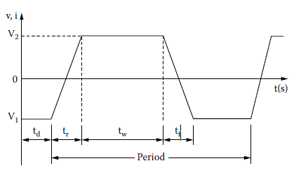
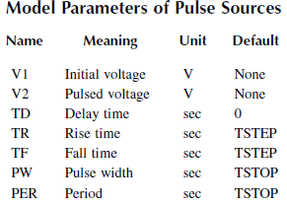
SPICE - Lab
Pulse Source
The symbol of a pulse source is PULSE and the general form is
PULSE (V1 V2 TD TR TF PW PER)

Slide 12
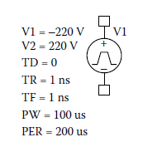
SPICE - Lab
Example:
PULSE (−220 220 0 1NS 1NS 100US 200US)

Slide 13
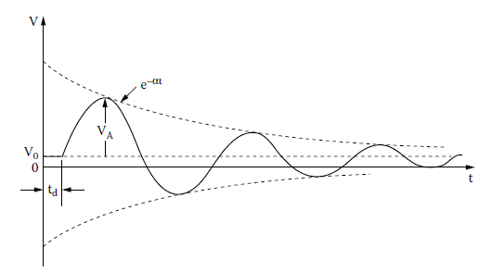
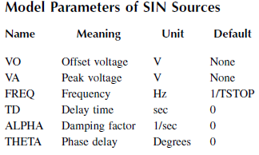
SPICE - Lab
Sinusoidal Source
The symbol of a sinusoidal source is SIN and the general form is
SIN (V0 VA FREQ TD ALP THETA)
Typical Statements
SIN (0 1V 10KHZ 10US 1E5)

Slide 14
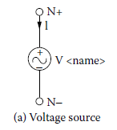
SPICE - Lab
Independent Voltage Source
The symbol of an independent voltage source is V, and the general form is
V<name> N+ N−
+ [dc <value>]
+ [ac <(magnitude) value> <(phase) value>]
+ [(transient specifications)]
Typical Statements
  V1 15 0 6V ; By default, DC specification of 6 V
  V2 15 0 DC 6V ; DC specification of 6 V
  VAC 5 6 AC 1V ; AC specification of 1 V with 0° delay
  VACP 5 6 AC 1V 45DEG ; AC specification of 1 V with 45° delay
  VPULSE 10 0 PULSE (0 1 2NS 2NS 2NS 50NS 100NS) ; Transient pulse
  VIN 25 22 DC 2 AC 1 30 SIN (0 2V 10KHZ)

Slide 15
SPICE - Lab
Types of Analysis
Spice allows various types of analysis. Each analysis is invoked by including its command statement.
Some analysis are:
DC
AC
Transient

Slide 16
SPICE - Lab
DC Analysis
Example: The statements for DC sweep are
.DC VIN −5V 10V 0.25V
sweeps the voltage VIN linearly.
.DC LIN IIN 50MA −50MA 1MA
sweeps the current IIN linearly.

Slide 17
SPICE - Lab
Transient Analysis
The format for performing a transient response is
.TRAN TSTEP TSTOP
where
  TSTEP is the time increment and
  TSTOP is the final (stop) time
Example: The statement for the transient response from 0 to 400 μsec with a 1-μsec increment is
.TRAN 1US 400US

Slide 18
SPICE - Lab
AC Analysis
The command for performing frequency response takes one of the general forms.
.AC LIN NP FSTART FSTOP
.AC OCT NP FSTART FSTOP
.AC DEC NP FSTART FSTOP
Where,
  NP is the number of points in a frequency sweep.
  FSTART is the starting frequency, and
  FSTOP is the ending frequency.
  LIN, OCT, or DEC specifies the type of sweep.
Only one of LIN, OCT, or DEC must be specified in the statement.

Slide 19
SPICE - Lab
A circuit file that is read by Spice may be divided into five parts:
(1) the title, which describes the type of circuit, or any comments
(2) The circuit description, which defines the circuit elements and the set of model Parameters
(3) the analysis description, which defines the type of analysis
(4) the output description, which defines the way the output is to be presented
(5) the end of program

Slide 20
SPICE - Lab
Note the following:
  The first line is the title line, and it may contain any type of text.
  The last line must be the .END command.
  The order of the intervening lines is not important and does not affect the results of the simulation.
  If a Spice statement is longer than one line, it can be continued in the next line. A continuation line is identified by a plus sign (+) in the first column of the next line. The continuation lines must follow one another in the proper order.
  A comment line may be included anywhere and should be preceded by an asterisk (*).
  The number of blanks between items is not significant (except for the title line). Tabs and commas are equivalent to blanks. For example, “ ” and “ ” and “ , ” and “ , ” are all equivalent.
  Spice statements or comments can be in either upper- or lowercase letters.

Slide 21
SPICE - Lab
LIST OF EXPRIMENTS
To study a SPICE program and various commands like ac commands, dc commands, transient commands etc.
To write a SPICE Program to plot the V-I characteristics of diode and also to observe the effect of temperature on the V-I characteristics.
To write SPICE program to plot the transfer characteristics of various clipper circuit and simulate it. To write SPICE program for positive and negative clamper circuits and to simulate it.
To write spice program for Half wave rectifier and FWCT rectifier with capacitor filter.
To write SPICE program to plot the input and output characteristics of BJT in common emitter configuration.
To write a SPICE program for CE amplifier and simulate it.
To write SPICE program to plot the static drain characteristics of MOS transistor.

Slide 22
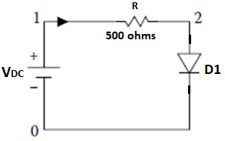
Exp-2(a): Diode Characteristics
** Diode Characteristics***
VDC 1 0 5V
RL 1 2 500
D1 2 0 diode
.MODEL diode D(Vj=.75 Cjo=175p Rs=.25 Eg=1.11 M=.5516 Nbv=1.6989 N=1 Bv=8.1 Fc=.5 Ikf=0 +Ibv=20.245m Is=880.5E-18 Xti=3)
.save all @D1[id]
.DC VDC 0 5 0.1
.control
run
plot @D1[id] vs v(2)
plot @D1[id] vs v(1)
.endc
.end

Slide 23

Exp-2(b):Effect of Temperature on Diode Characteristics
** Effect of temp on Diode Characteristics***
VDC 1 0 DC 5V
RL 1 2 500
D1 2 0 diode
.MODEL diode D(Vj=.75 Cjo=175p Rs=.25 Eg=1.11 M=.5516 Nbv=1.6989 N=1 Bv=8.1 Fc=.5 Ikf=0 Ibv=20.245m +Is=880.5E-18 Xti=3)
.save all @D1[id]
.DC VDC 0 5 0.1 TEMP -75 75 25
.control
run
set hcopydevtype=postscript
set hcopypscolor=1
set color0=white
set color1=black
set color2=red
set color3=blue
set color4=violet
set color5=rgb:3/8/0
set color6=rgb:4/0/0
set hcopywidth=800
set hcopyheight=600
plot @D1[id] vs v(2)
.endc
.end

Slide 24
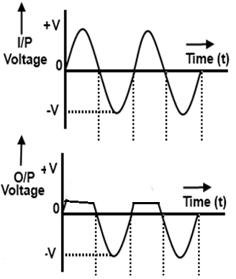
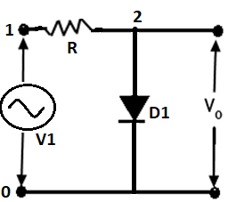
Exp-3(a): Positive Shunt Clipper
*** Positive shunt clipper***
V1 1 0 SIN(0 5V 1K 0 0 0)
R1 1 2 500
D1 2 0 diode
.MODEL diode D(Vj=.75 Cjo=175p Rs=.25 Eg=1.11 M=.5516 +Nbv=1.6989 N=1 Bv=8.1 Fc=.5 Ikf=0 Ibv=20.245m Is=880.5E-+18 Xti=3)
.tran 0.01m 10m
.control
run
plot v(1)
plot v(2)
.endc
.end

Slide 25
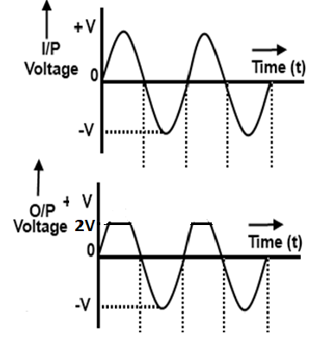
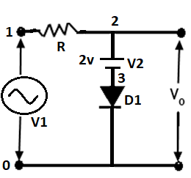
Exp-3(b): Positive Biased Shunt Clipper
*** Positive biased shunt clipper***
V1 1 0 SIN(0 5V 1K 0 0 0)
R1 1 2 500
V2 2 3 dc 2V
D1 3 0 diode
.MODEL diode D(Vj=.75 Cjo=175p Rs=.25 Eg=1.11 M=.5516 Nbv=1.6989 N=1 Bv=8.1 Fc=.5 Ikf=0 Ibv=20.245m Is=880.5E-18 Xti=3)
.tran 0.01m 10m
.control
run
plot v(1)
plot v(2)
.endc
.end

Slide 26
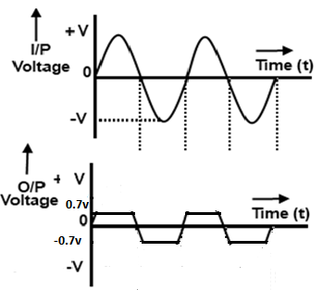
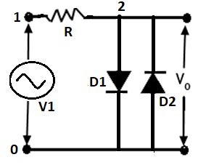
Exp-3(c): Double Shunt Clipper
*** Double shunt clipper***
V1 1 0 SIN(0 5V 1K 0 0 0)
R1 1 2 500
D1 2 0 diode
D2 0 2 diode
.MODEL diode D(Vj=.75 Cjo=175p Rs=.25 Eg=1.11 M=.5516 +Nbv=1.6989 N=1 Bv=8.1 Fc=.5 Ikf=0 Ibv=20.245m Is=880.5E-18 +Xti=3)
.tran 0.01m 10m
.control
run
plot v(1)
plot v(2)
.endc
.end

Slide 27
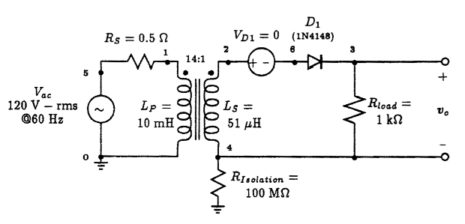
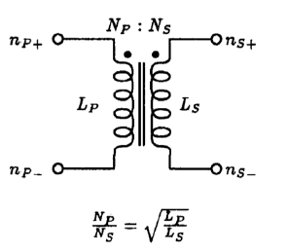
Exp-4(a): Half Wave Rectifier
**Half-Wave Rectifier Circuit**
* ac line voltage
Vac 5 0 sin (0 169V 60Hz)
Rs 5 1 0.5
* transformer section
Lp 1 0 10mH
Ls 2 4 51uH
Kxfrmr Lp Ls 0.999
* isolation resistor (allows secondary side to pseudo-float)
Risolation 4 0 100Meg
* diode current monitor
VD1 2 6 0
* rectifier circuit
D1 6 3 D1N4148
Rload 3 4 1kOhm
.model D1N4148 D (Is=0.1pA Rs=16 CJO=2p Tt=12n Bv=100 Ibv=0.1p)
.TRAN 0.5ms 100ms
.control
run
plot V(3,4)
plot V(2,4)
plot V(1)
*plot V(6,3)
.endc
.end

Slide 28
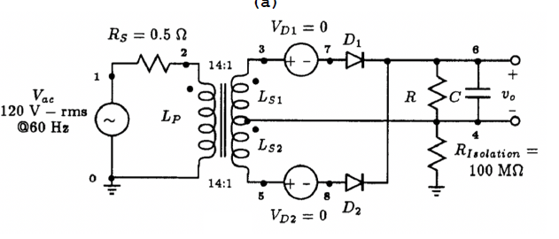
Exp-4(b): Full Wave Center Tap Rectifier with Capacitor Filter
***Full-Wave Center Tap Rectifier Circuit***
* ac line voltage
Vac 1 0 sin(0 169V 60Hz)
Rs 1 2 0.5
* transformer section with center-tap
Lp 2 0 10mH
Ls1 3 4 51uH
Ls2 4 5 51uH
K12 Lp Ls1 0.999
K13 Lp Ls2 0.999
K23 Ls1 Ls2 0.999
Risolation 4 0 100Meg
VD1 3 7 0
VD2 5 8 0
D1 7 6 D1N4148
D2 8 6 D1N4148
C 6 4 50u
R 6 4 1k
.model D1N4148 D (Is=0.1pA Rs=16 CJO=2p Tt=12n Bv=100 Ibv=0.1p)
.TRAN 0.1ms 100ms 0ms 0.1ms
.control
run
plot V(6,4) V(3,4)
plot I(VD1) I(VD2)
.endc
.end

Slide 29
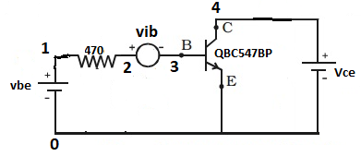
Exp-5(a):Input Characteristics of BJT
***Input characteristics of BJT***
vbe 1 0 dc 5v
r1 1 2 470
vce 4 0 dc 5v
*Voltage source of 0 V to measure current
vib 2 3 dc 0v
*Specifying BJTs in this manner-
*name collector base emitter modelname as in model file
q1 4 3 0 QBC547BP
.MODEL QBC547BP NPN(IS=1.8E-14 BF=400 NF=0.9955 VAF=80 IKF=0.14 ISE=5E-14
+ NE=1.46 BR=35.5 NR=1.005 VAR=12.5 IKR=0.03 ISC=1.72E-13 NC=1.27 RB=0.56
+ RE=0.6 RC=0.25 CJE=1.3E-11 TF=6.4E-10 CJC=4E-12 VJC=0.54 TR=5.072E-8 )
* DC analysis
.dc vbe 0 5 0.1 vce 0 5 1
.control
run
plot vib#branch vs v(3)
.endc
.end

Slide 30
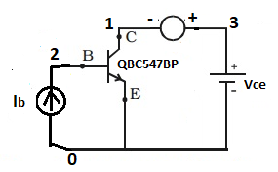
Exp-5(b):Output Characteristics of BJT
***Output characteristics of BJT***
ib 0 2 5m
*Voltage source of 0 V to measure current
vic 3 1 dc 0v
vce 3 0 dc 5v
*Specifying BJTs in this manner-
*name collector base emitter modelname as in model file
q1 1 2 0 QBC547BP
.MODEL QBC547BP NPN(IS=1.8E-14 BF=400 NF=0.9955 VAF=80 IKF=0.14 ISE=5E-14
+ NE=1.46 BR=35.5 NR=1.005 VAR=12.5 IKR=0.03 ISC=1.72E-13 NC=1.27 RB=0.56
+ RE=0.6 RC=0.25 CJE=1.3E-11 TF=6.4E-10 CJC=4E-12 VJC=0.54 TR=5.072E-8 )
*DC analysis
.dc vce 0 5 1 ib 0 5m 1m
.control
run
plot vic#branch vs v(1)
.endc
.end

Slide 31
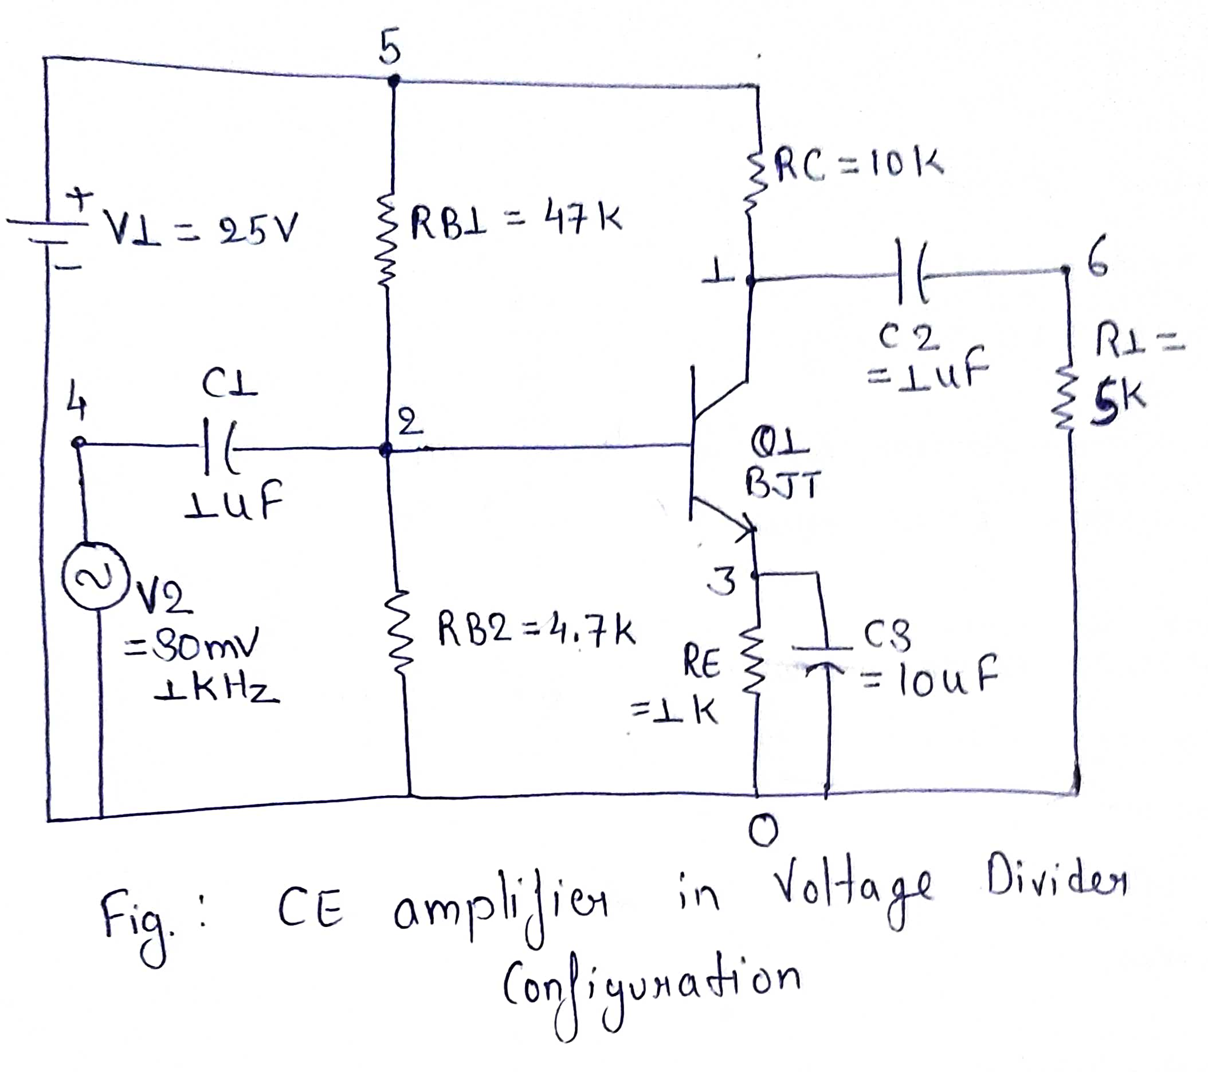
Exp-6:BJT Amplifier in CE configuration
***BJT CE AMPLIFIER***
Q1 1 2 3 QBC547BP
.MODEL QBC547BP NPN(IS=1.8E-14 BF=400 NF=0.9955 VAF=80 IKF=0.14 ISE=5E-14
+ NE=1.46 BR=35.5 NR=1.005 VAR=12.5 IKR=0.03 ISC=1.72E-13 NC=1.27 RB=0.56
+ RE=0.6 RC=0.25 CJE=1.3E-11 TF=6.4E-10 CJC=4E-12 VJC=0.54 TR=5.072E-8 )
RB1 2 5 47K
RB2 2 0 4.7K
RE 3 0 1K
RC 5 1 10K
R1 6 0 5K
C1 2 4 1U
C2 1 6 1U
C3 3 0 10U
V1 5 0 DC 25
V2 4 0 SIN(0 30m 0.5K 0 0 0)
.TRAN 0.0001 30m
.control
run
Plot V(6)
Plot V(4)
.endc
.END

Slide 32
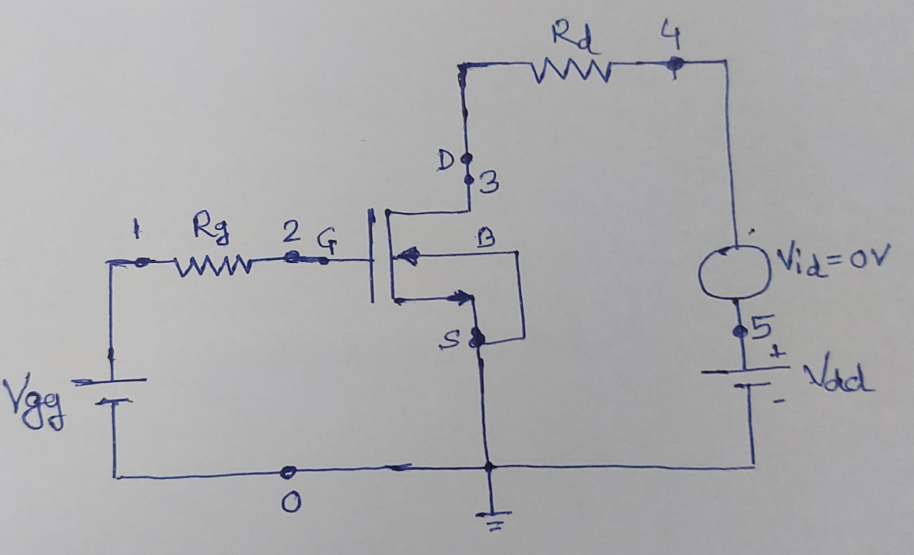
Exp-7: Vds – Id characteristics of NMOS
I-V Characteristics of NMOS Transistor
*Fixing gate bias at 3.5V
vgg 1 0 dc 3.5v
rg 1 2 680
*Specifying NMOS in this manner-
*name drain gate source body modelname as in model file
m1 3 2 0 0 CMOSN
.include CMOSN.txt
rd 3 4 100
*DC source of 0v to measure current
vid 5 4 dc 0v
vdd 5 0 dc 0v
*DC analysis to sweep vds from 0 to 5V
.dc vdd 0 3.5 0.01 vgg 0 3.5 1
.control
run
plot vid#branch vs v(3)
.endc
.end

