Slide 1
Unit 5
Fundamental of Measurement
(EI 27002)
A.C. Bridges
Signal and waveform generators, digital voltmeter, digital counter, multimeter, distortion analyzers, insertion loss, RF power and impedance measurement
Bindu Solanki
Electronics and Instrumentation Engineering Department,
Shri G. S. Institute of Technology and Science,
Indore (M.P.)

Slide 2
Distortion analyzer
A sinusoidal signal to the input of an ideal linear amplifier will produce a sinusoidal output waveform. However, in most cases the output waveform is not an exact replica of the input signal because of various types of distortion.
The extent to which the output waveform of an amplifier differs from the waveform at the input is a measure of the distortion intro­duced by the inherent nonlinear characteristics of active devices such as bipolar or field-effect transistors or by passive circuit components. The amount of distortion can be measured with a distortion analyzer.
When an amplifier is not operating in a linear fashion, the output signal will be distorted. Distortion caused by nonlinear operation is called amplitude distortion or harmonic distortion.
It can be shown mathematically that an amplitude-distorted sine wave is made up of pure sine-wave components including the fundamental frequency f of the input signal and harmonic multiples of the fundamental frequency, 2f, 3f, 4f . . . , and so on.

Slide 3
When harmonics are present in considerable amount, their presence can be ob­served with an oscilloscope. The waveform displayed will either have unequal positive and negative peak values or will exhibit a change in shape.
In either case, the oscilloscope will provide a qualitative check of harmonic distortion. However. the distortion must be fairly severe (around 10%) to be noted by an untrained observer.
In addition, most testing situations require a better quantitative measure of harmonic distortion.
Harmonic distortion can be quantitatively measured very accurately with a harmonic distortion analyzer, which is generally referred to simply as a distortion analyzer.

Slide 4
Fundamental suppression harmonic analyzer
A block diagram for a fundamental-suppression harmonic analyzer is shown in Fig. When the instrument is used. switch S, is set to the "set level" position, the band pass filter is adjusted to the fundamental frequency and the attenuator network is adjusted (from lowest to highest) to obtain a full-scale voltmeter reading.
Switch S, is then set to the "distortion" position, the rejection filter is turned to the fundamental frequency, and the attenuator is adjusted (from lowest to highest) for a maximum reading on the voltmeter.

Slide 5
Total harmonic distortion can be expressed as the ratio of the rms value of all the harmonics to the rms value of the total signal including distortion.
On the basis of the assumption that any distortion caused by the components within the analyzer itself or by the oscillator signal are small enough to be neglected.
where
THD = the total harmonic distortion
E_{f} =the amplitude of the fundamental frequency including the harmonics
E₂ E₃ E_{n} =are the amplitude of the individual harmonics
THD= Ʃ(harmonics) fundamental

Slide 6
EXAMPLE : Compute the total harmonic distortion of a signal that contains a fundamen­tal signal with an rms value of 10 V, a second harmonic with an rms value of 3 V, a third harmonic with an rms value of 1.5 V, and a fourth harmonic with an rms value of 0.6 V.
Solution

Slide 7
Waveform analyzers
Harmonic distortion analyzers measure the total harmonic content in waveforms.
It is frequently desirable to measure the amplitude of each harmonic individually.
This is the simplest form of analysis in the frequency domain and can be performed with a set of tuned filters and a voltmeter.
Such analyzers have various names, including frequency-selective voltmeters, carrier frequency voltmeters, selective level meters, and wave analyzers. Any of these names is quite descriptive of the instrument’s primary function and mode of operation.

Slide 8
A very basic wave analyzer is shown in Fig. The primary detector is a simple LC circuit which is adjusted for resonance at the frequency of the particular harmonic component to be measured.
The intermediate stage is a full-wave rectifier, and the indicating device may be a simple do voltmeter that has been calibrated to read the peak value of a sinusoidal input voltage.
Since the LC filter in given figure passes only the frequency to which it is tuned and provides a high attenuation to all other frequencies.
Many tuned filters connected to the indicating device through a selector switch would be required for a useful wave analyzer.
A basic waveform analyzer is shown
here:

Slide 9
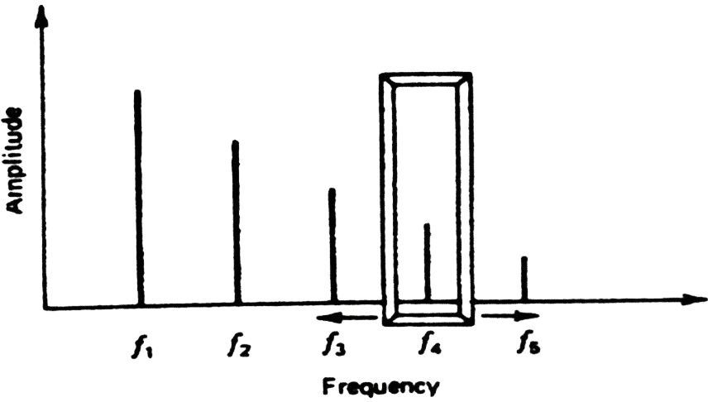
Since wave analyzers sample successive portions of the frequency spec­trum through a movable "window." as shown in figure, they are called non-real-time analyzers. However. if the signal being sampled is a periodic waveform.
Its energy distribution as a function of frequency does not change with time. Therefore, this sampling technique is completely satisfactory.

Slide 10
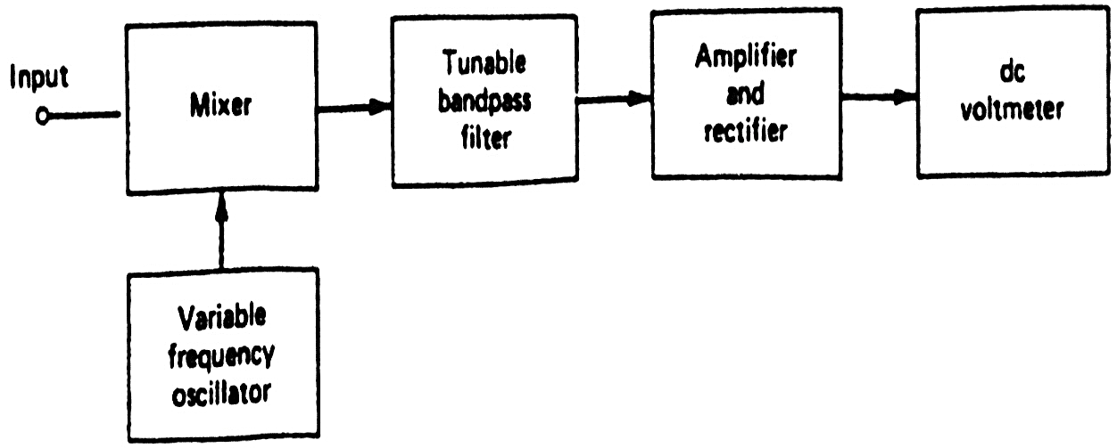
Heterodyne type wave analyzer
Rather than using a set of tuned filters, the heterodyne wave analyzer shown in Fig., uses a single, tunable, narrow-bandwidth filter, which may be regarded as the window through which a small portion of the frequency spectrum is examined at any one time.
In this system, the signal from the internal, variable-frequency oscillator will heterodyne with the input signal to produce output signals having frequencies equal to the sum and difference of the oscillator frequency f_{o} and the input frequency f_{i}.
In a typical heterodyne wave analyzer, the band pass filter is tuned to a frequency higher than the maximum oscillator frequency. Therefore, the "sum frequency" signal expressed as is passed by the filter to the amplifier. F_{s} = f_{o} + f_{i}

Slide 11
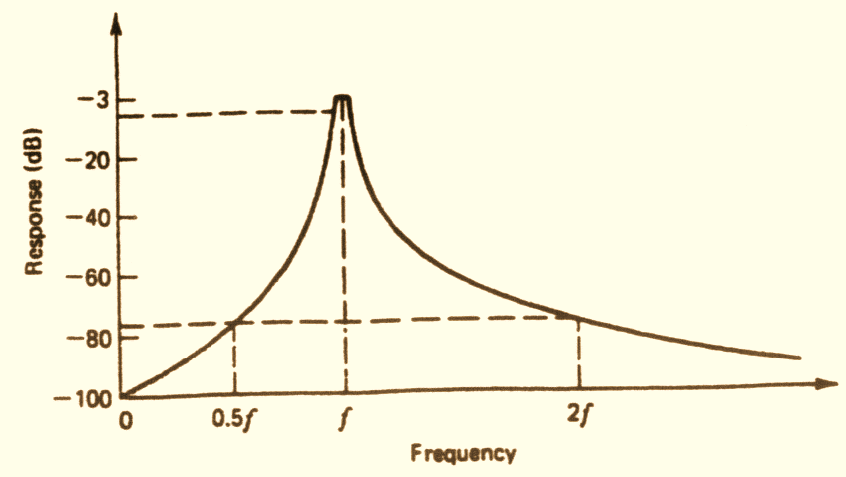
As the frequency of the oscillator is decreased from its maximum frequency, a point will be reached where f_{o} + f_{i} is within the band of frequencies that the bandpass filter will pass. The signal out of the filter is amplified and rectified.
The indicated quantity is amplified and rectified. The indicated quantity is then proportional to the peak amplitude of the fundamental component of the input signal. As the frequency of the oscillator is further decreased, the second harmonic and higher harmonics will be indicated.
The bandwidth of the filter is very narrow, typically about 1 % of the frequency of interest. The attenuation characteristics of a typical commercial audio-frequency analyzer is shown in Fig. As can be seen, at 0.5f and at 2f, attenuation is approximately 75 dB.

Slide 12
The bandwidth of a heterodyne wave analyzer is usually constant.
This can make analysis very difficult, if not impossible in applications in which the frequency of the waveform being analyzed does not remain constant during the time required for a complete analysis. which is generally several seconds. For example, the bandwidth of an audio-frequency analyzer may be on the order of 10 Hz.
A 2% change in the fundamental frequency of a 1-kHz signal will shift the frequency of the fifth harmonic by 100 Hz, which is well outside the bandwidth of the instrument.

Slide 13
Example: A wave analyzer has a fixed bandwidth of 4 Hz. By what percentage can a 60-Hz signal change without disrupting measurement of the fourth har­monic with the instrument?
Solution:
The maximum frequency shift at any harmonic is one-half the bandwidth or 2 Hz. A frequency shift of 0.5 Hz at the fundamental frequency will cause a 2-Hz frequency shift at the fourth harmonic. The percent change in fre­quency is

Slide 14
The principal applications of wave analyzers are:
Amplitude measurement of a single component of a complex waveform.
Amplitude measurement in the presence of noise and interfering signals.
Measurement of signal energy within a well-defined bandwidth.

Slide 15
Function generator
Function generator is basically a signal generator that produces different types of waveforms at the output. It has the ability to produce waveforms such as sine wave, square wave, a triangular wave, sawtooth wave etc. An adjustable frequency range is provided by the function generator which is in the range of some Hz to several 100KHz.
There exist various function generators that have the ability to produce two different waveforms simultaneously by using two different output terminals.
Function Generator is a versatile instrument as an extensive variety of frequencies and waveforms are produced by it. The various waveforms generated by the function generator are suitable for various applications. It provides adjustment of wave shape, frequency, magnitude and offset but requires a load connected before adjustment.

Slide 16
This instrument not only varies the characteristics of the waveform but also has the capability to add a dc offset to the signal. Mostly these are only able to operate at low frequency but some costly models can also be operated at the higher frequency.
As we have discussed earlier that it can generate 2 different waveforms simultaneously at the two different terminals. So, it can be a useful feature as different output are required for particular applications. It provides another important feature as they have the capability of phase locking to an external source.
This implies that a function generator can phase lock another function generator and the output of both can be displaced in phase.
The figure below shows the block diagram of the function generator.
A frequency control network used here whose frequency is controlled by the variation in the magnitude of current. The current sources 1 and 2 drives the integrator.

Slide 17
Digital multimeter

Slide 18
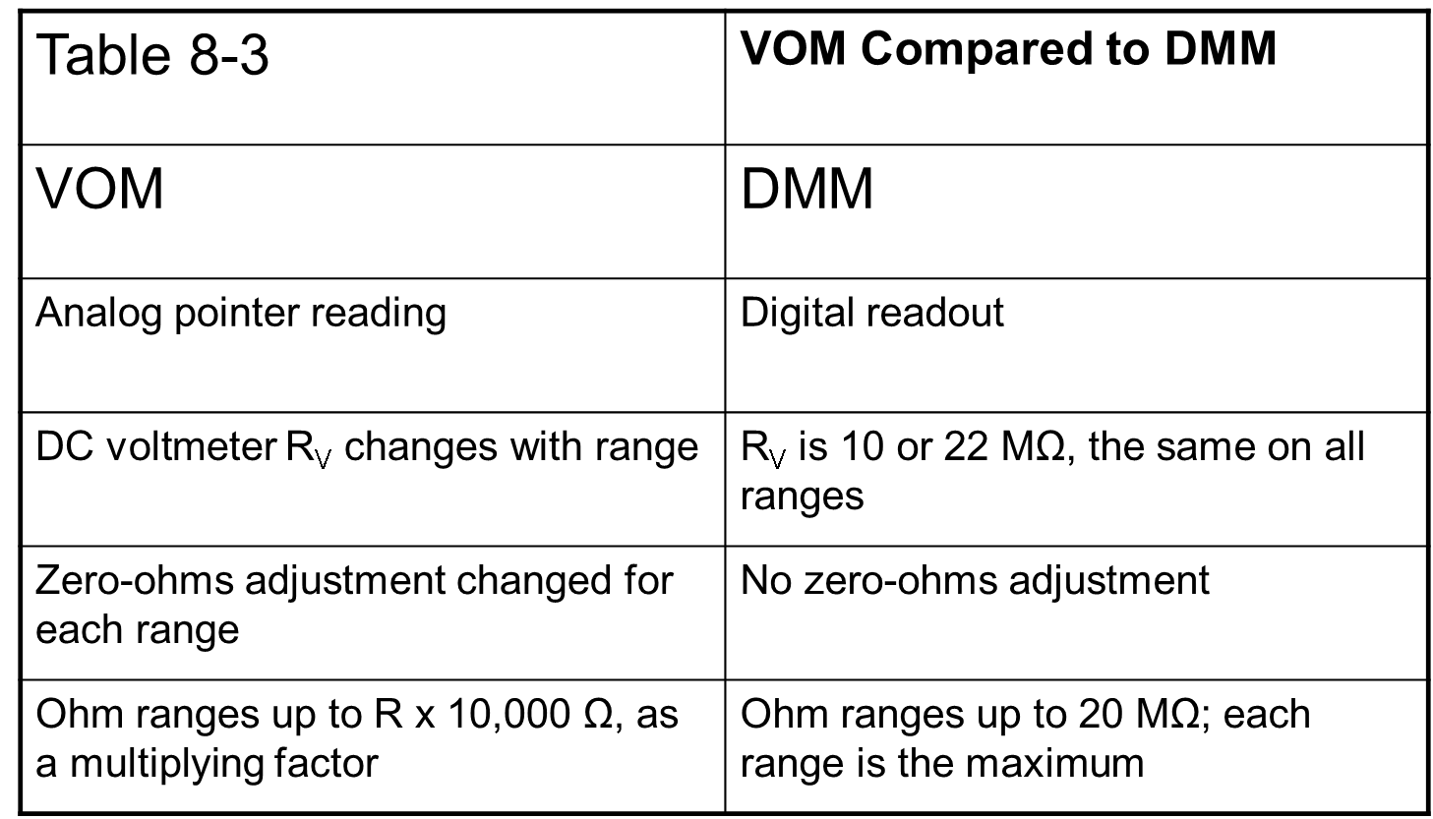
Digital multimeter (DMM)
A digital multimeter or DMM is a useful instrument for measuring voltage, current and resistance, and some meters have a facility for testing transistors and capacitors. (VOM:Voltage, Ohm meter).
They eliminate the human error that often occurs in reading different scales on an analog meter with a pointer.

Slide 19
Common DMM Symbols
~ AC Voltage Ground
--- DC Voltage ( Capacitor
Hz Hertz μF MicroFarad
+ Positive μ Micro
Negative m Milli
Ω Ohms M Mega
* Diode K Kilo
))) Audible Continuity OL Overload
These symbols are often found on multimeter and schematics. They are designed to symbolize components and reference values.

Slide 20
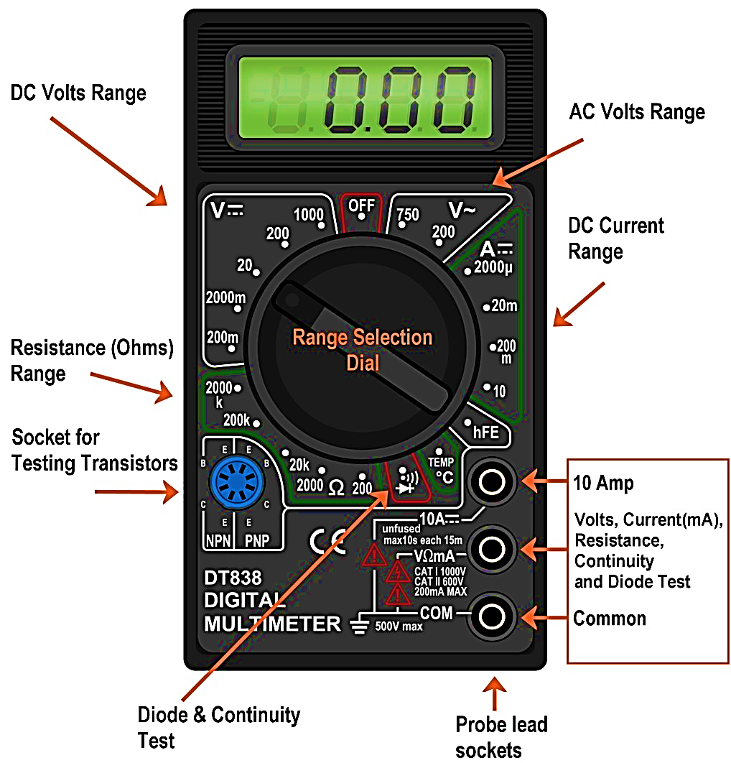
Sections of Digital multimeter

Slide 21
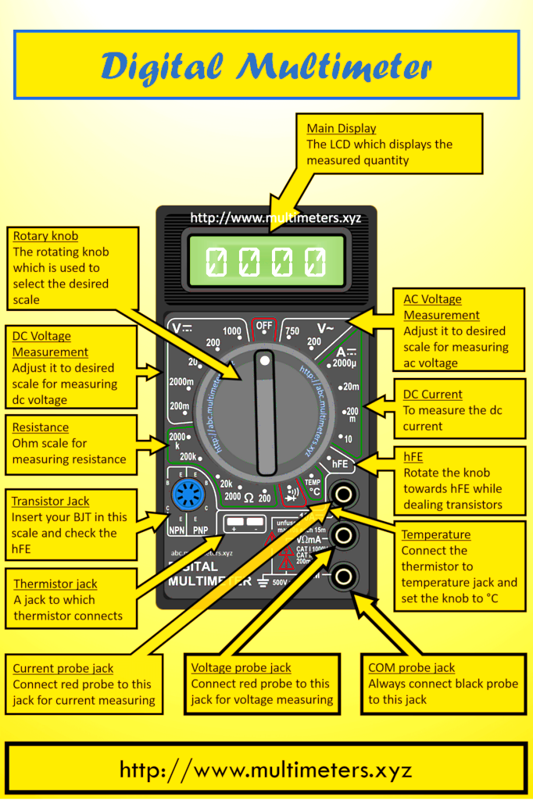
Sections of Digital multimeter

Slide 22
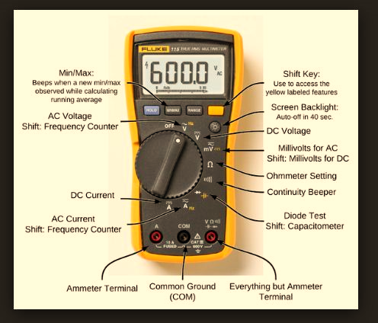
Sections of Digital multimeter

Slide 23
Voltage measurement
Voltage (V) is the unit of electrical pressure; one volt is the potential difference needed to cause one amp of current to pass through one ohm of resistance.
Voltage is broke up into 2 sections AC & DC
Alternating Current (AC) is house voltage (110vac)
Direct Current (DC) is battery voltage (12vdc)
On switched meters use one value higher than your expected value.
Be very careful to not touch any other electronic components within the equipment and do not touch the tips to each other while connected to anything else.
To measure voltage connect the leads in parallel between the two points where the measurement is to be made. The multimeter provides a parallel pathway so it needs to be of a high resistance to allow as little current flow through it as possible

Slide 24
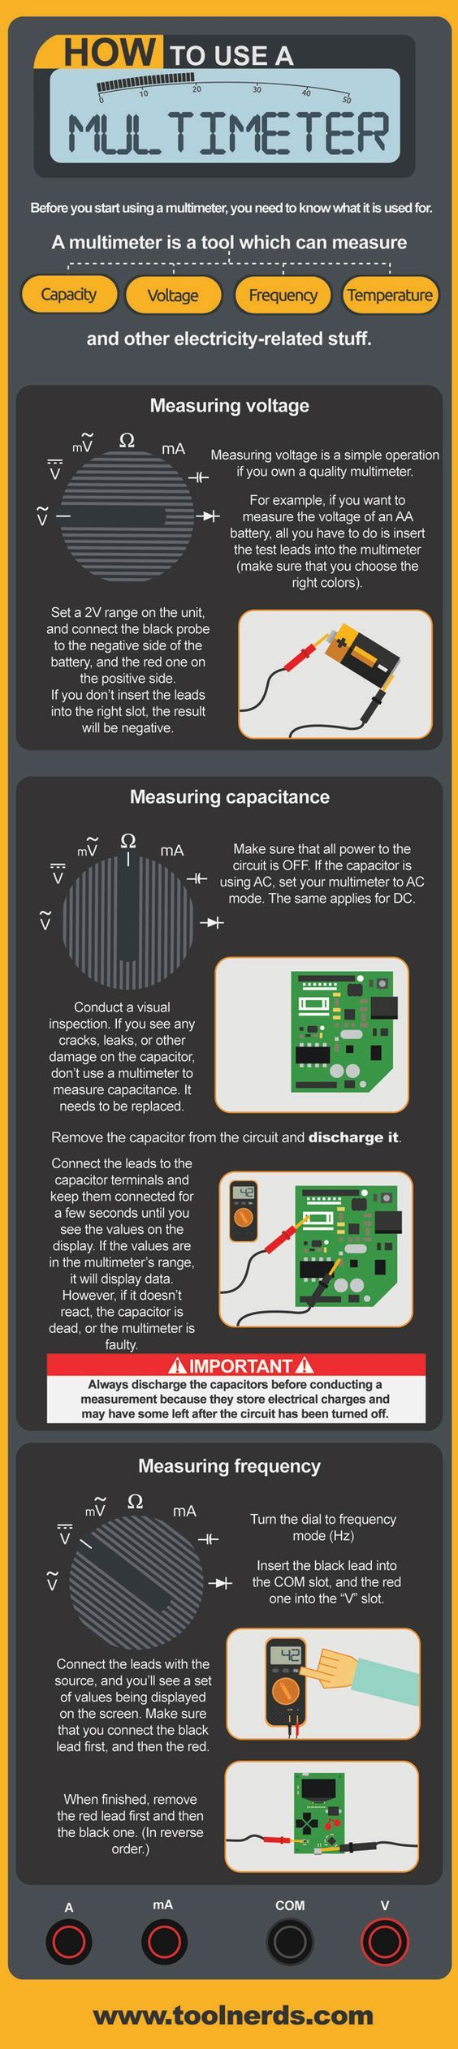
Voltage measurement

Slide 25
Measuring resistance and continuity
Resistance (W) is the opposition to current. Resistance is measured in Ohm's
Disconnect power source before testing.
Remove component or part from system before testing.
Measure using lowest value, if OL move to next level.
Testing for continuity is used to test to verify if a circuit, wire or fuse is complete with no open.
Audible continuity allows an alarm if circuit is complete.
If there is no audible alarm resistance of 1ohm to .1ohm should be present.

Slide 26
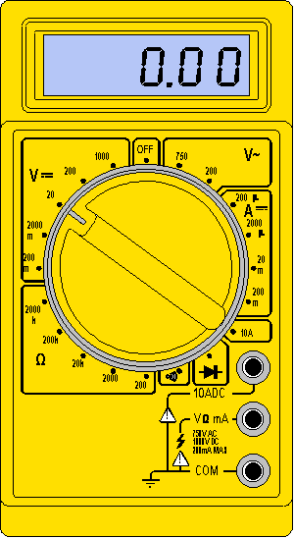
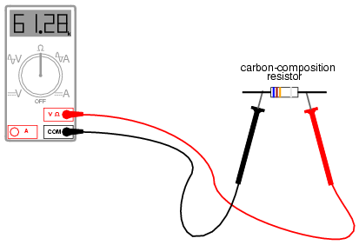
Measuring resistance
100Ω

Slide 27
Measuring continuity
.5Ω
Fuse
5 amp

Slide 28
Measuring current
Current (amps) is the flow of electrical charge though a component or conductor. Current is measured in amps or amperes.
Disconnect power source before testing.
Disconnect completed circuit at end of circuit.
Place multimeter in series with circuit.
Reconnect power source and turn ON.
Select highest current setting and work your way down.

Slide 29
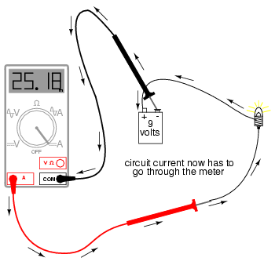
Measuring current
1.1amps

Slide 30
Capacitance measurement

Slide 31
Frequency measurement

Slide 32
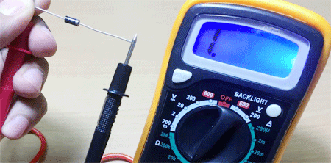
Diode check by using a digital multimeter
For this case, insert the probes into the sockets as that in the case of voltage measurement and set the selection switch to point towards diode check position shown in figure.
Now when the red lead of the multimeter is connected to positive terminal of the diode while its negative lead is connected to the negative terminal of the diode, then we have to get a low reading on the multimeter.
On the other hand, if we connect the red lead to the negative terminal of the diode and the black to the positive terminal, then we have to get a high value. If the readings obtained are as per our expectation, then we say that the diode is working properly; else no.

Slide 34
